Slide 1

Project :-
Analysis
Presented by :- Aman Dubey

Slide 2
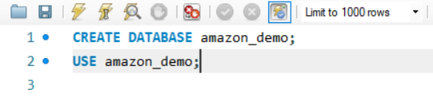


Amazon — Sales, Discounts & Profit Analysis
This project shows how Amazon manages sales, discounts, and profit using structured SQL data.
We use a simplified database model to analyze transactions realistically.
SQL queries reveal revenue flow, discount patterns, and cost impacts.
Insights highlight both performance strengths and operational inefficiencies.

Slide 3
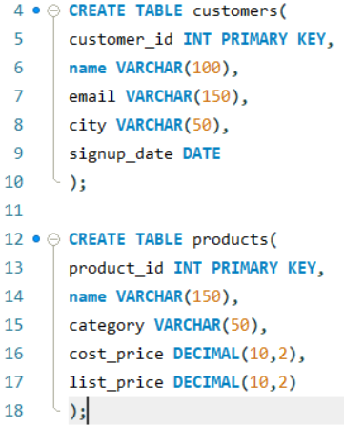
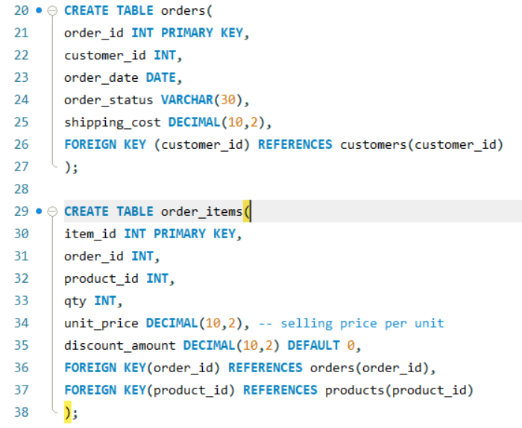
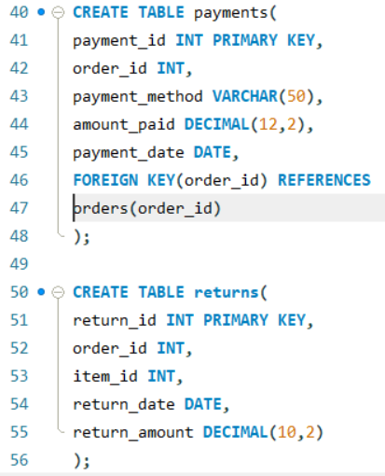
Data Model (tables)
Customers, products, Orders, Order items, Discounts, Payments, Returns.
Granularity: order -> Multiple order items; Discounts at item or order level.

Slide 4
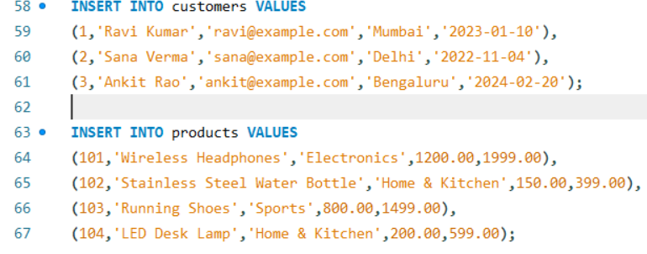
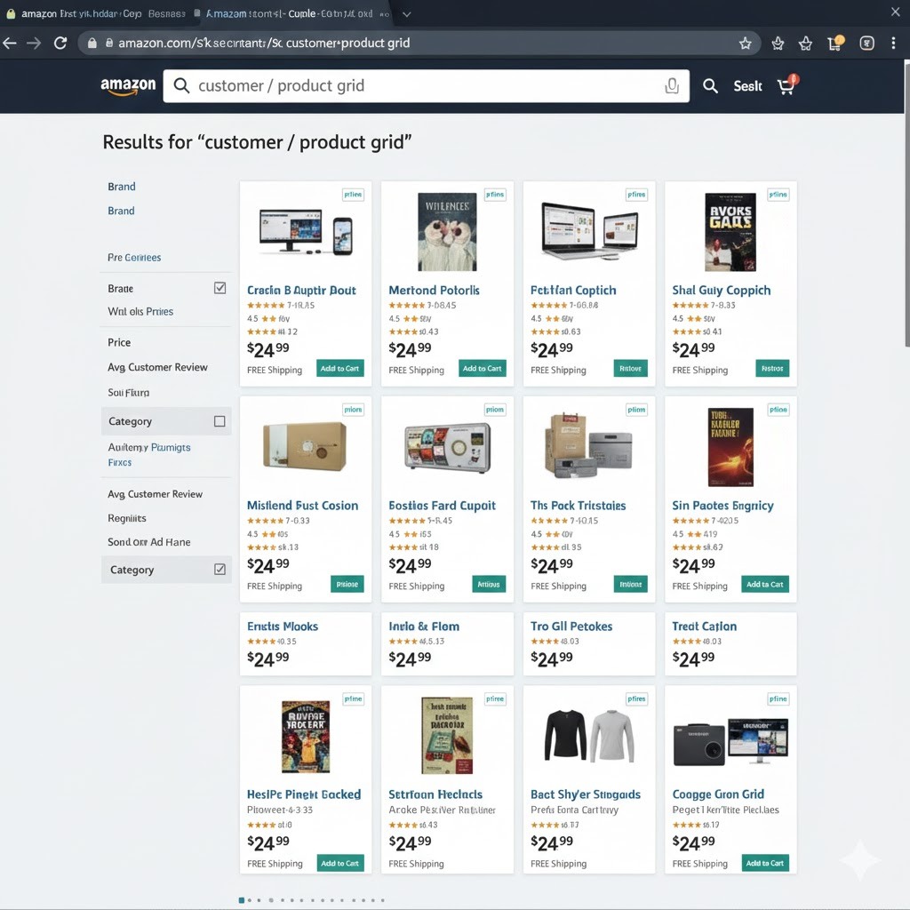
Sample Master Data
Customer data captures who buys, when they joined, and where they live.
Product data stores name, category, cost price, and list price.
These attributes allow margin, segment, and category-level insights.
Clean and structured master data improves downstream analysis accuracy.

Slide 5
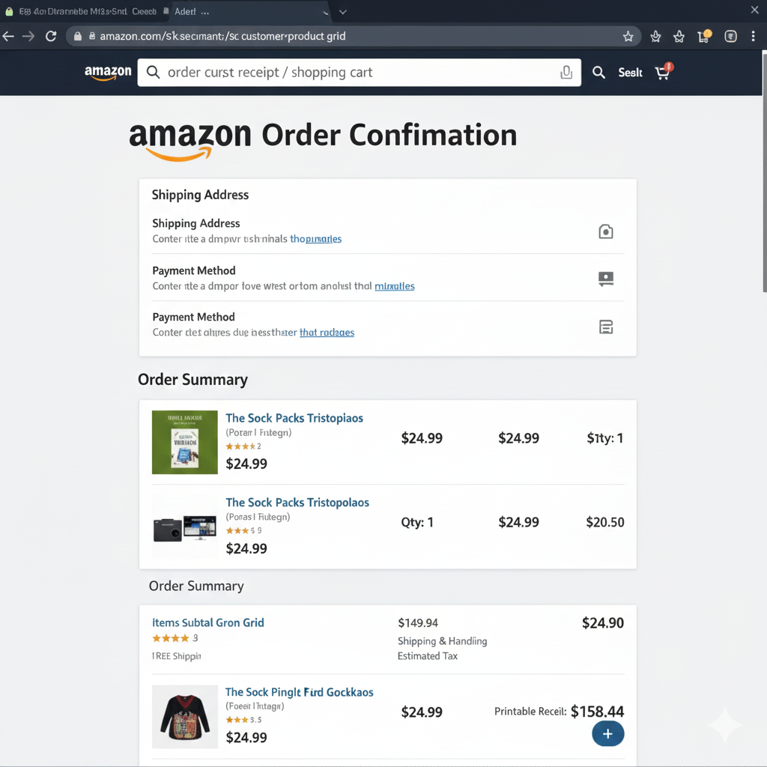
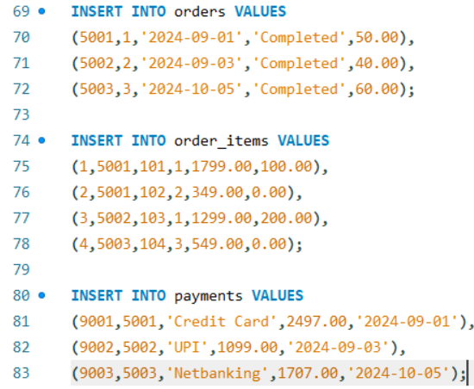
Sample Transactional Data
Orders store total activity, status, dates, and shipping cost.
Order items define what was sold, quantity, selling price, and discount.
Payments link financial confirmation back to each order.
This layer forms the foundation for revenue, AOV, and demand analysis.

Slide 6
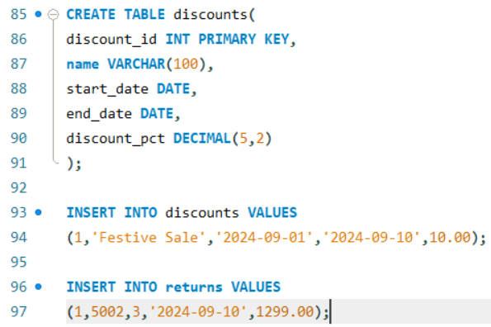

Discounts & Returns
Discounts impact profitability and must be tracked item-by-item.
Campaign discounts influence volume but reduce margin.
Returns directly reduce recognized revenue and inflate logistics cost.
Evaluating both is essential for accurate net profit measurement.

Slide 7
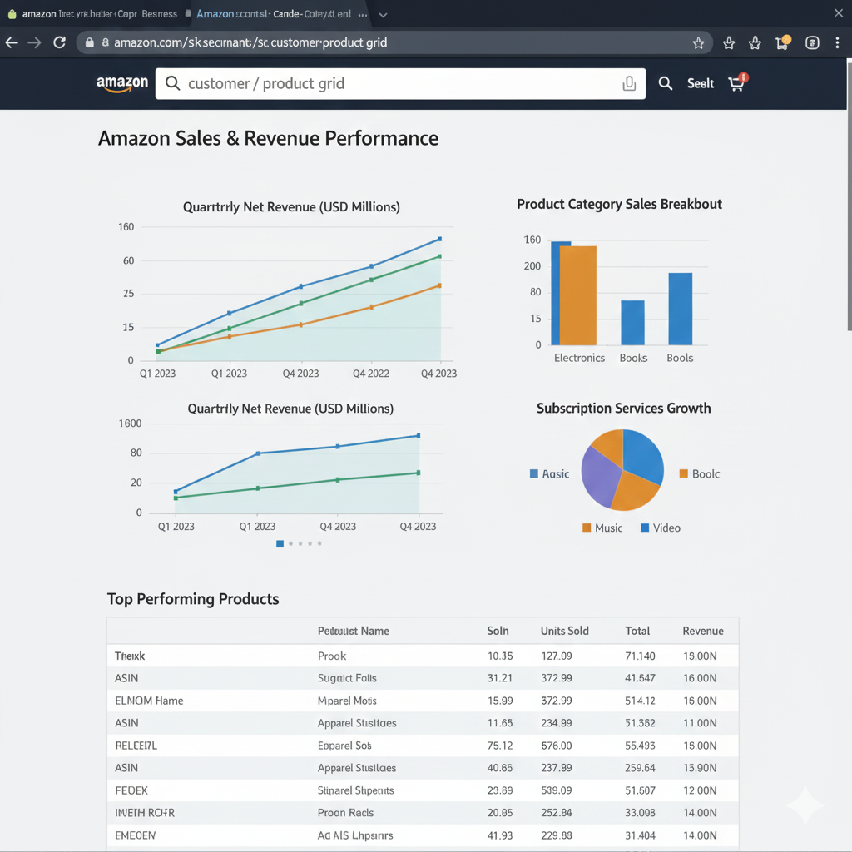
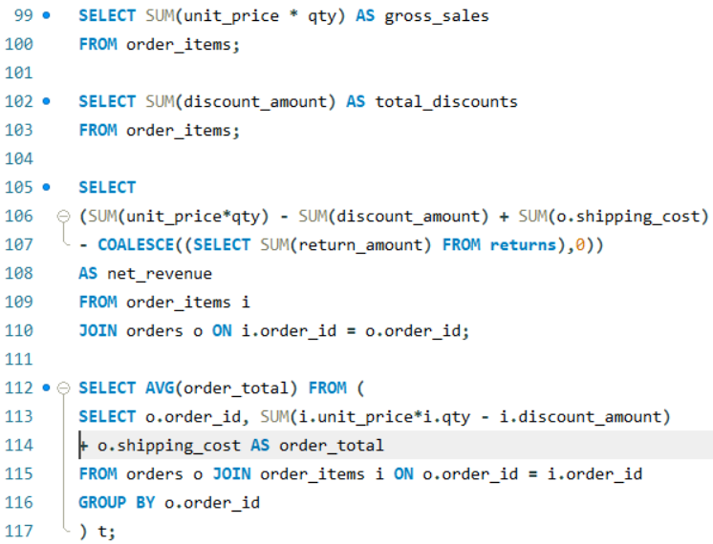
Key SQL: Sales & Revenue
Gross sales represent total item value before discounts.
Net revenue adjusts for discounts, returns, and shipping.
AOV shows the average customer spend per order.
These metrics help measure Amazon’s overall sales performance.

Slide 8

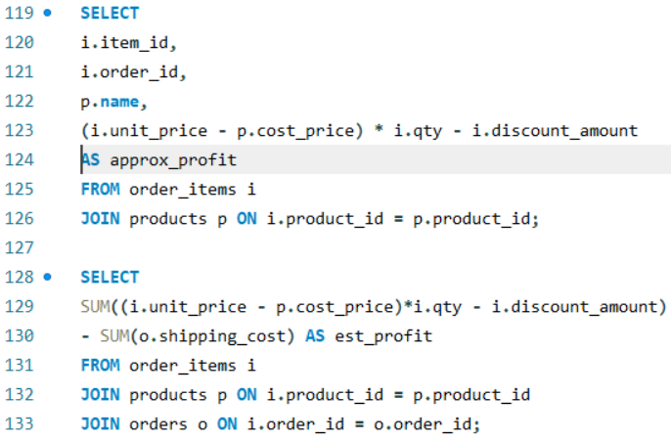
Key SQL: Profit & Margin
Profit depends on selling price, cost price, discounts, and shipping.
Product-level margin reveals which items drive profitability.
High revenue doesn’t guarantee high profit — cost structure matters.
These insights guide decisions on pricing and inventory strategy.

Slide 9
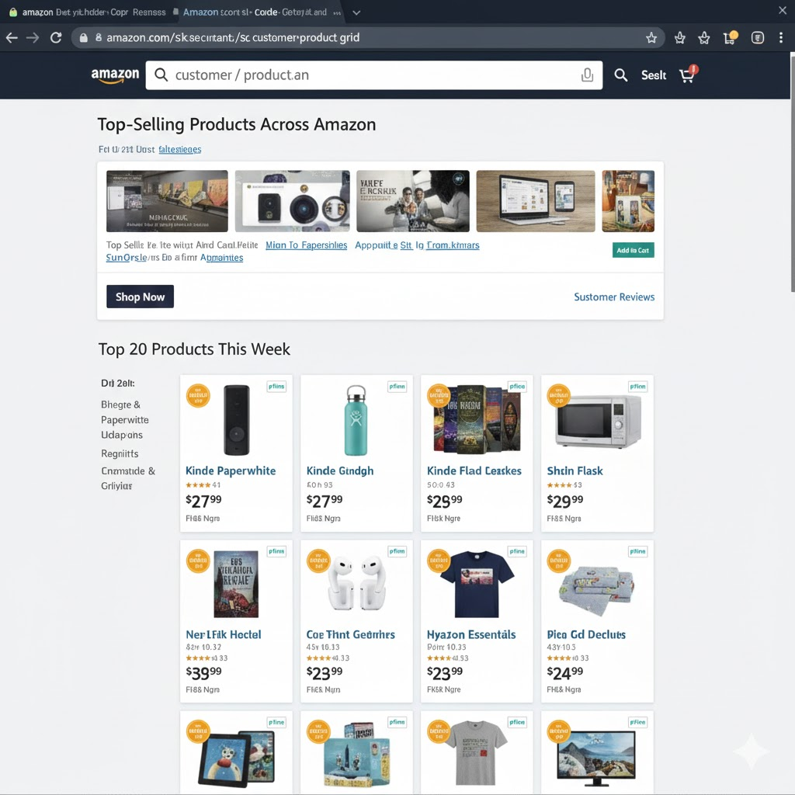
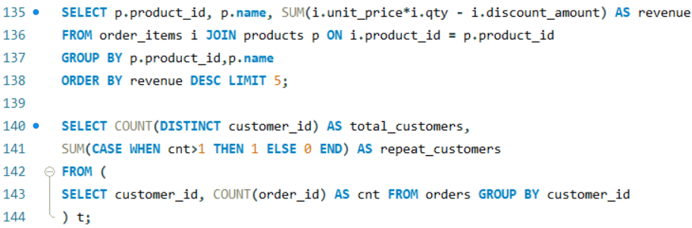
Analysis Queries: Customers & Products
Top-selling products show where demand is strongest.
Repeat customer rate indicates long-term business health.
Discount sensitivity varies across categories and customer types.
Discount sensitivity varies across categories and customer types.

Slide 10
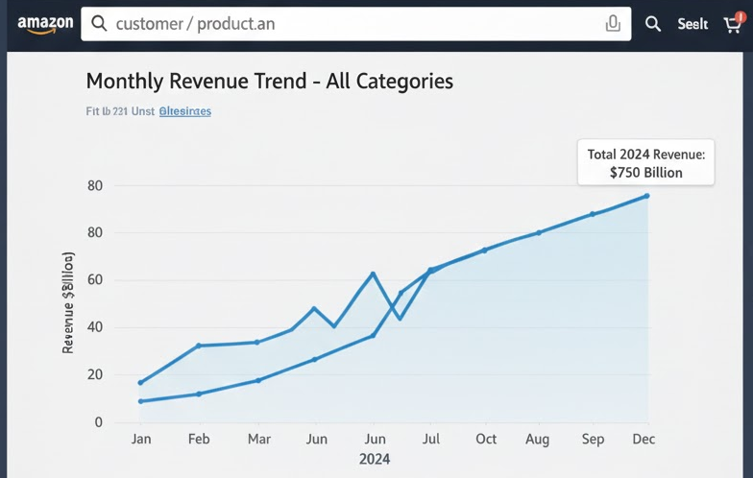
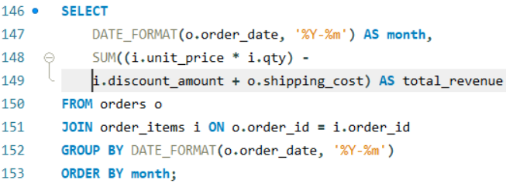
Time-series & Campaign Impact
Monthly revenue trends reveal growth patterns and seasonality.
Comparing pre-sale and sale periods measures campaign effectiveness.
Spikes in volume may not always mean higher profit.
Time-based analysis supports better inventory and pricing planning.

Slide 11

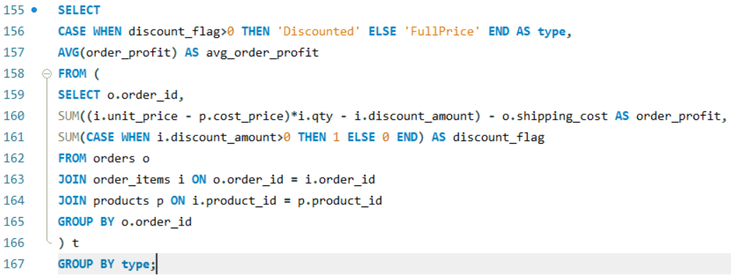
Findings & Recommendations
Discounts boost sales volume but can erode margins if misused.
High-ticket returns significantly damage net revenue.
Customer retention must be improved with targeted strategies.
Better discount planning and product-level optimization can raise profit.

